Slide 1
Project-Survival
Producer: Tom
Planner: Rief
Lead Art: Thomas
Lead Dev: Tom
UX: Lucas
Level Designer: Thomas
QA: Arne

Slide 2
Index
Concept
Workflow
Styleguide
Resource Budget
Functional Design
Technical Design
Planning
Organization

Slide 3
Concept
“Story”
Survival Shooter
Wave based

Slide 4
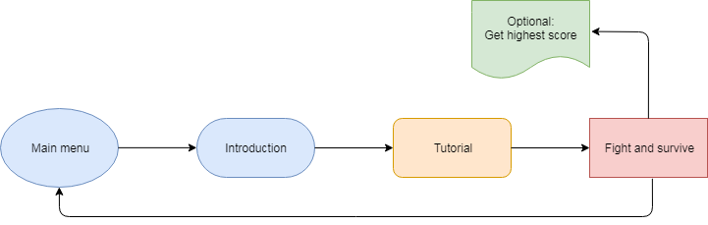
Workflow

Slide 5
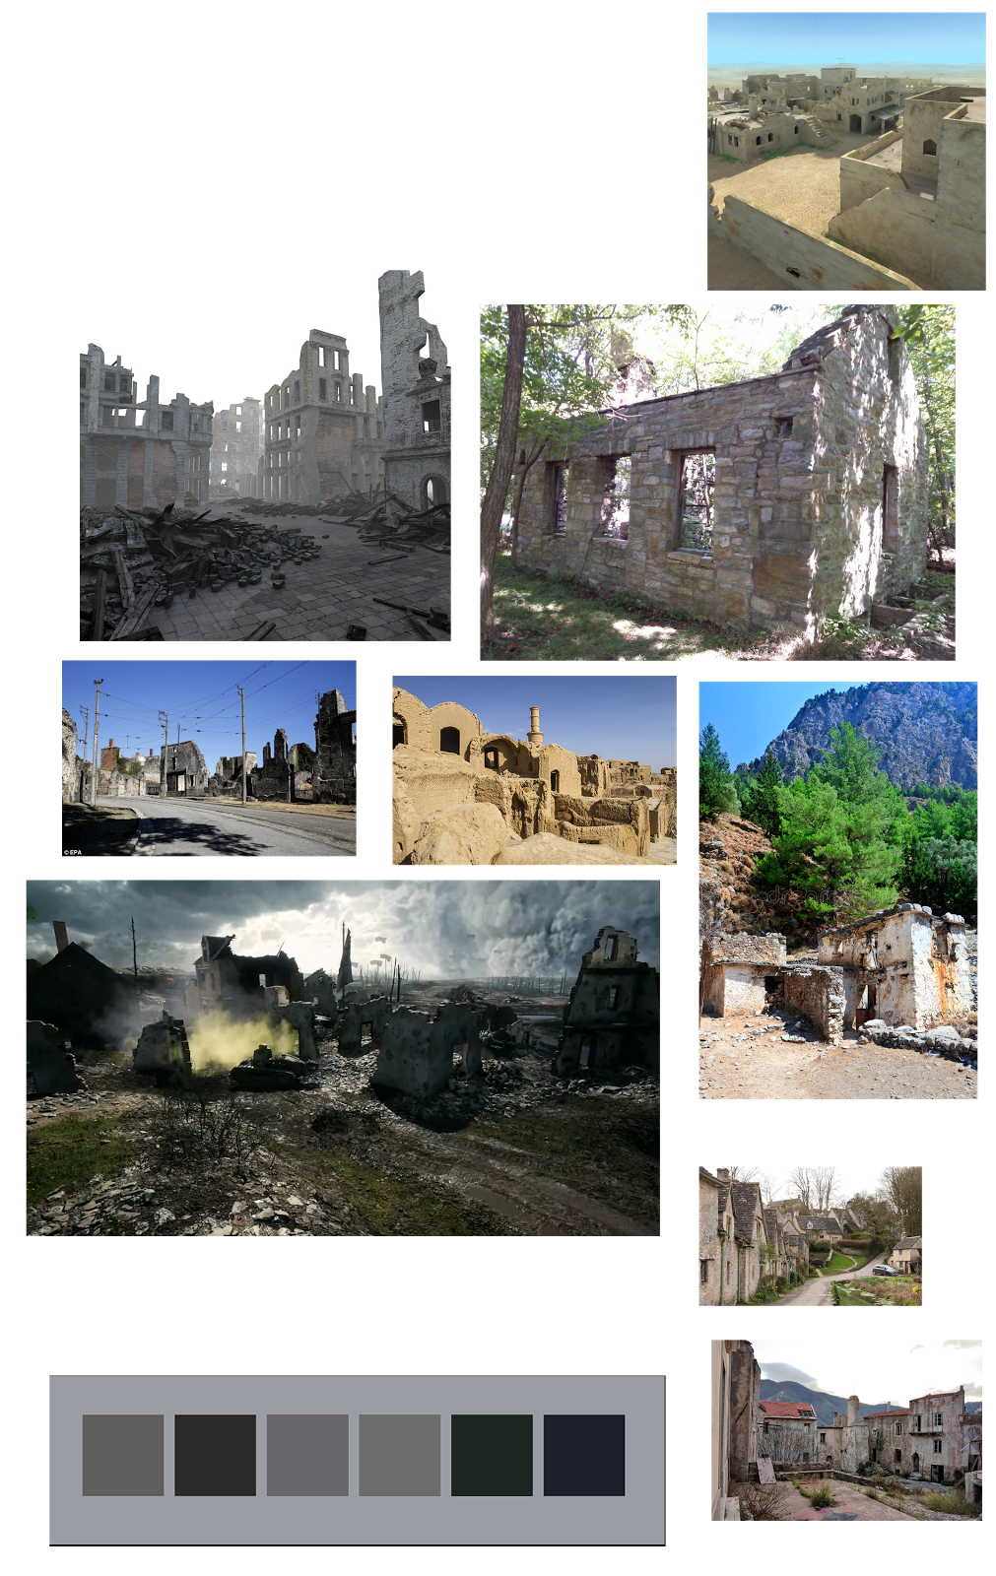
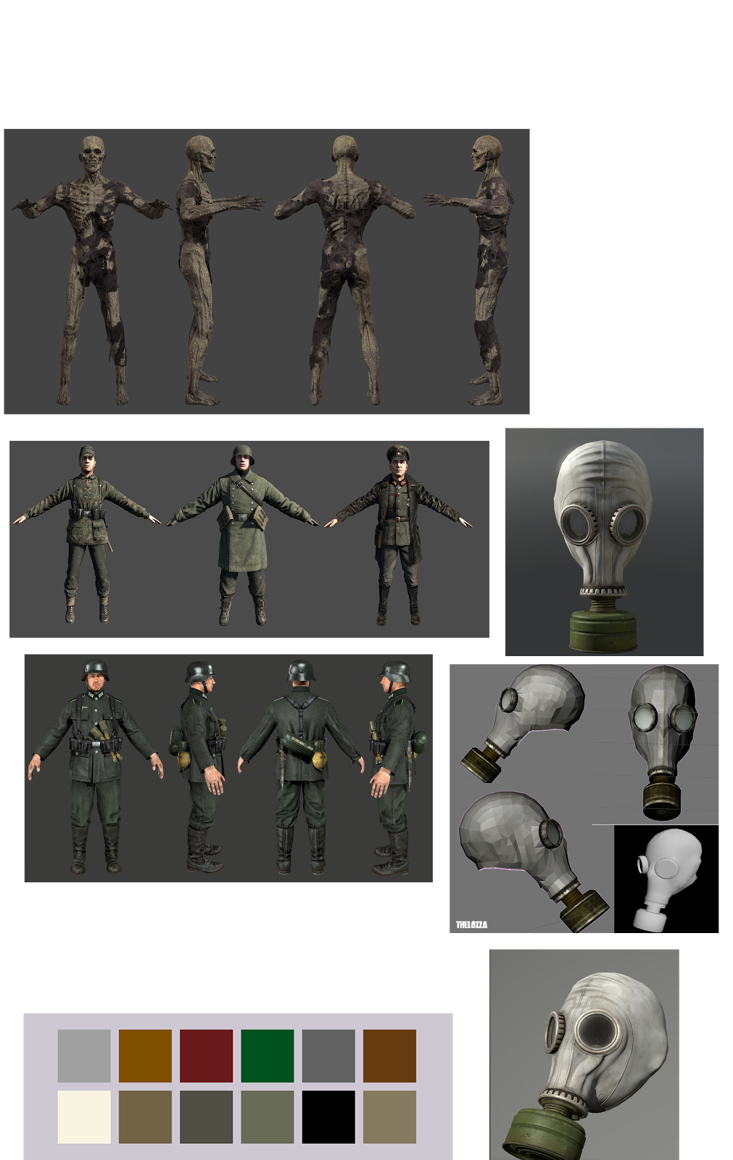
Styleguide

Slide 6
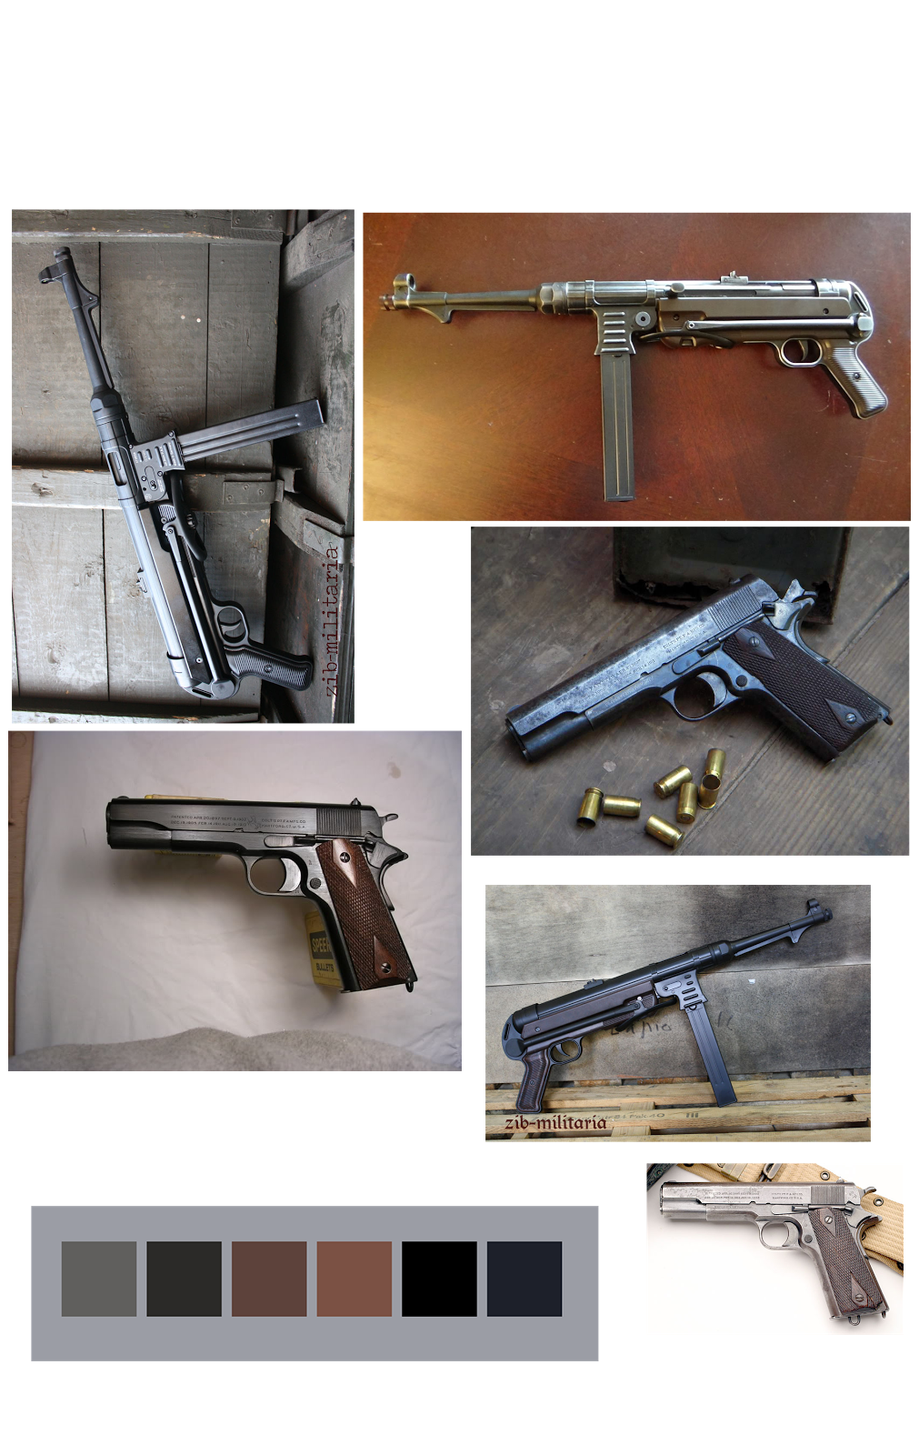
Styleguide

Slide 7
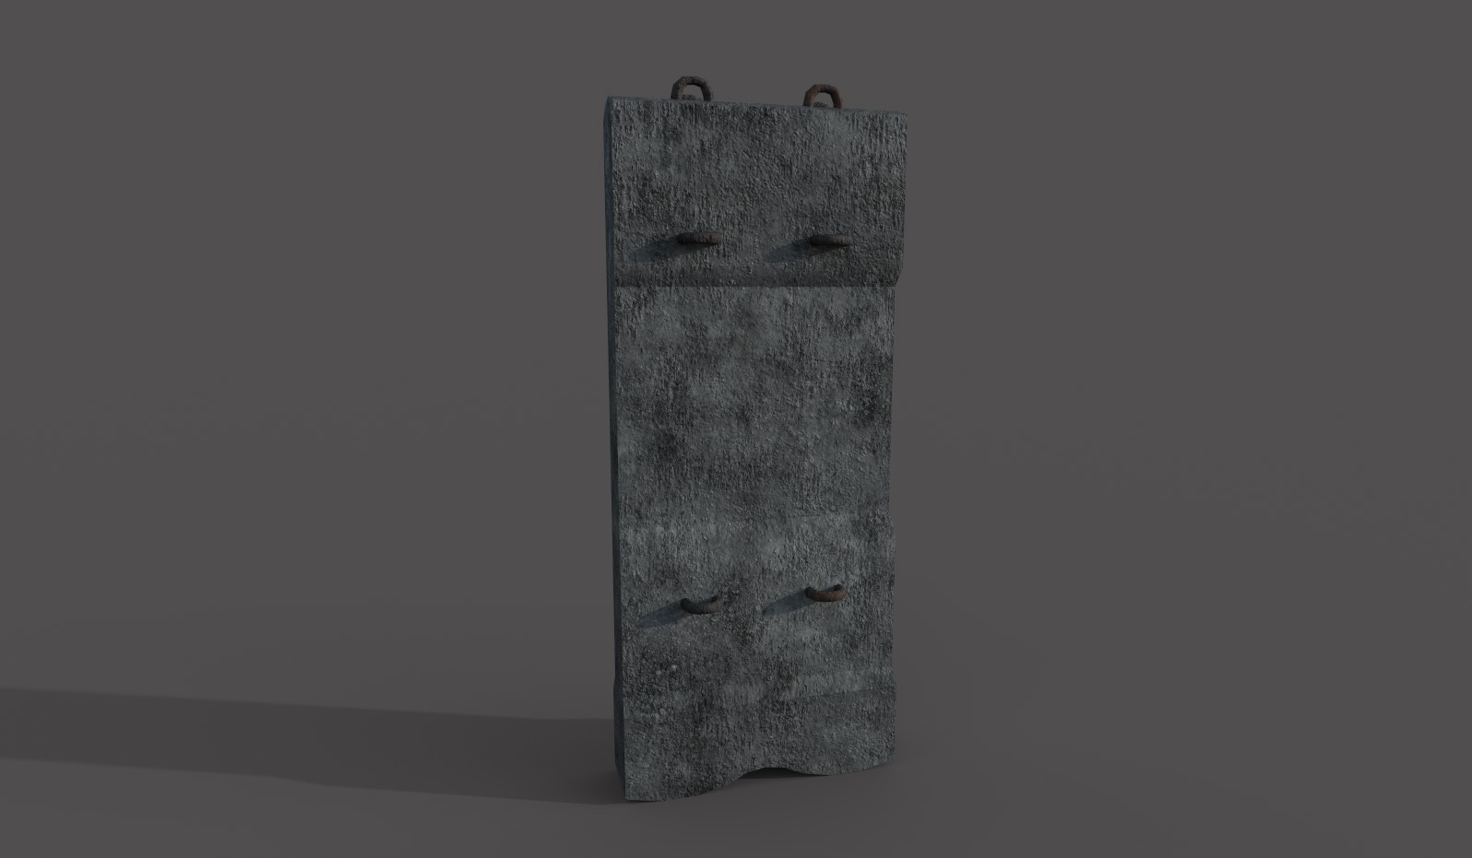
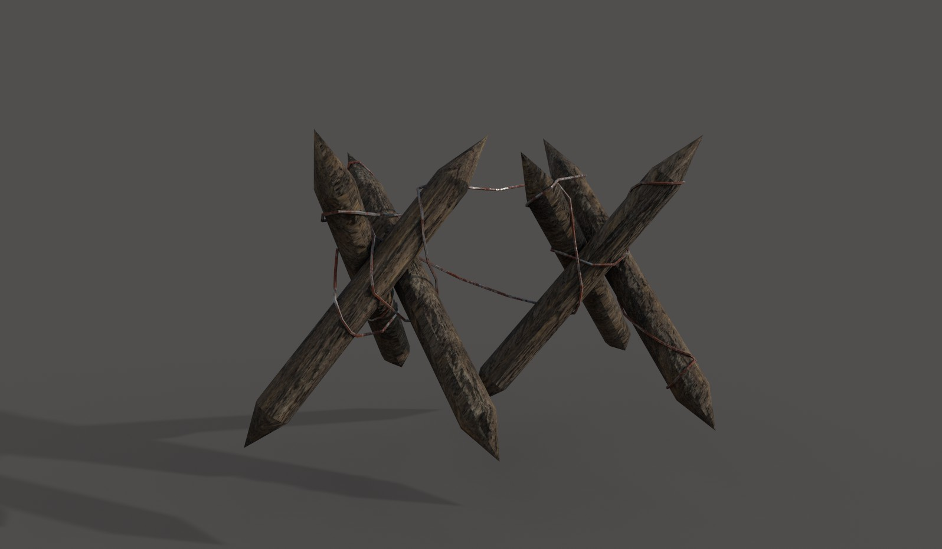
Current Assets

Slide 8
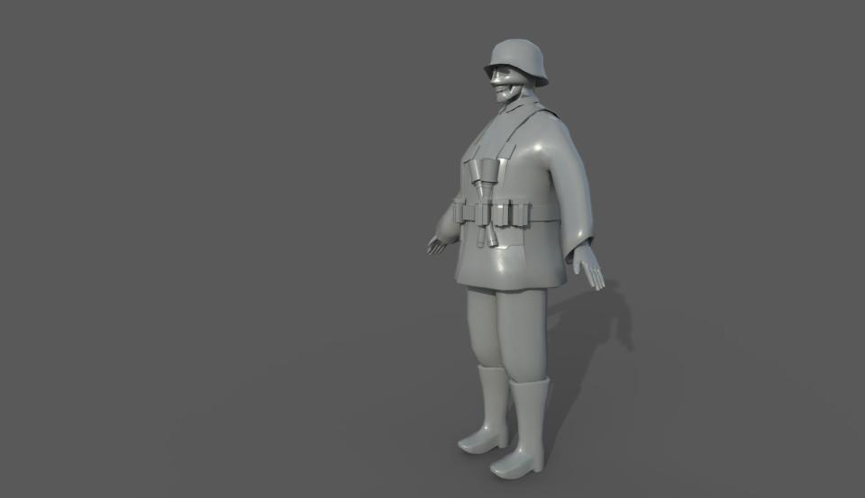
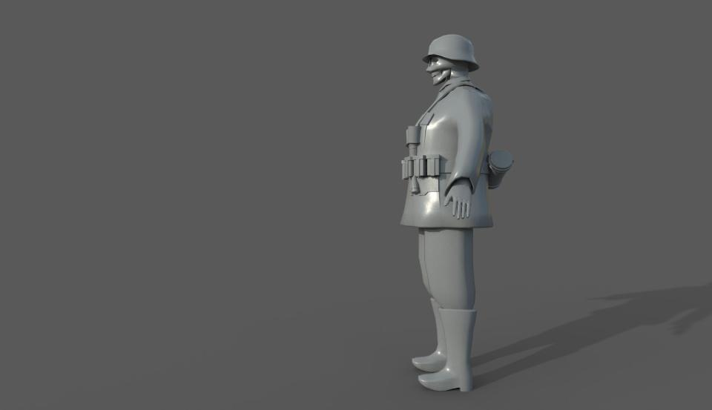
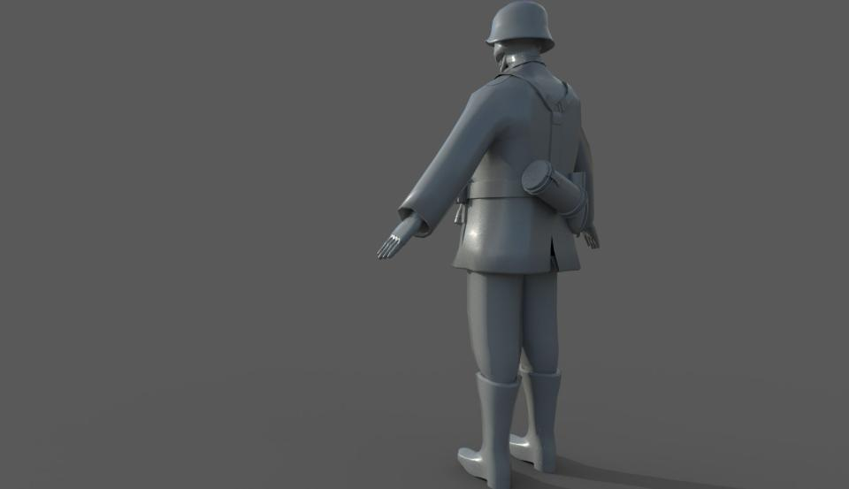
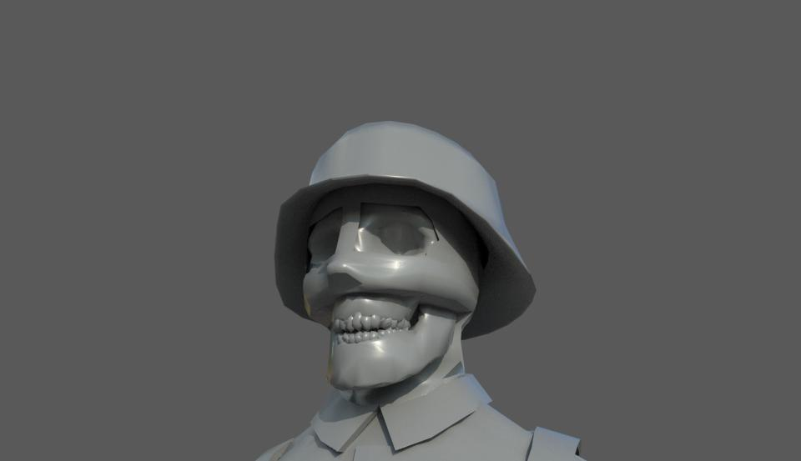
Current Assets

Slide 9
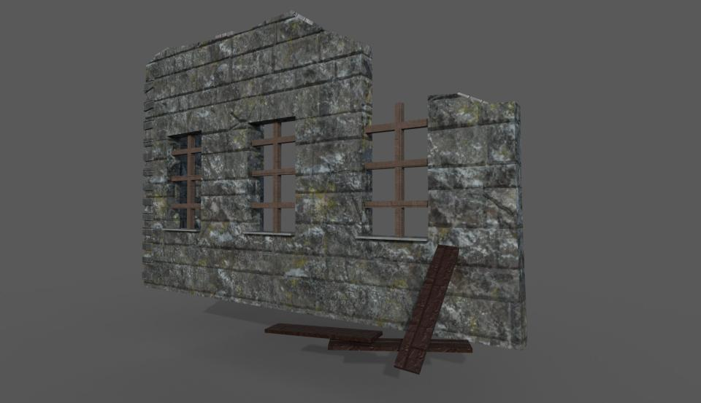
Current Assets

Slide 10
Resource Budget
Polycount
Texture resolution
Environment detail

Slide 11
Functional Design
Camera
Controls
Enemy
GUI
Level Design

Slide 12
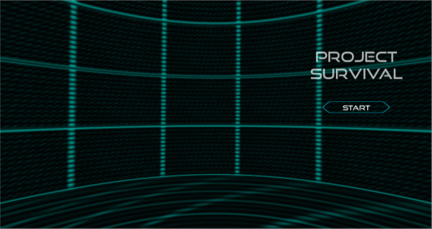
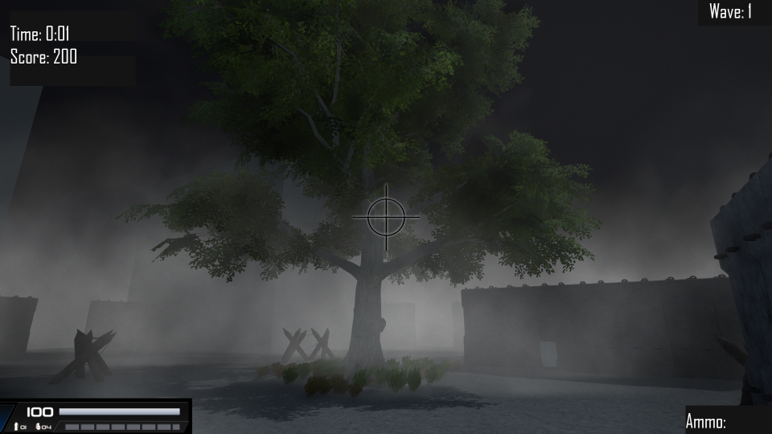
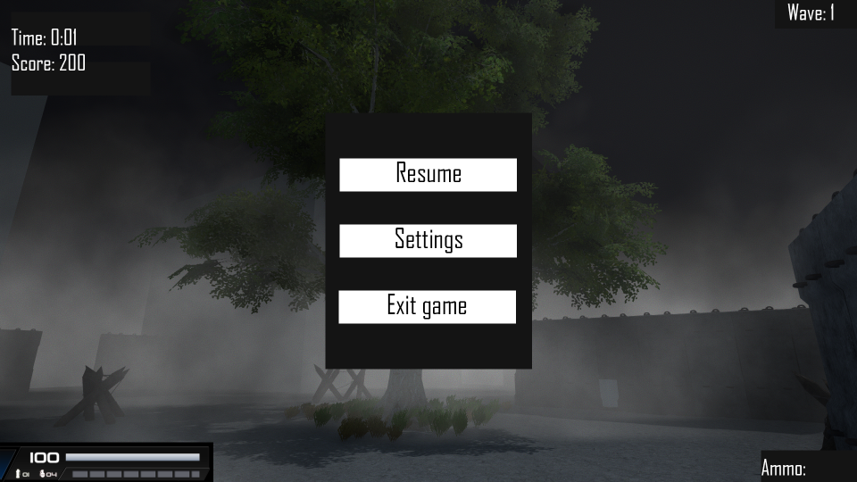
Functional Design
GUI

Slide 13
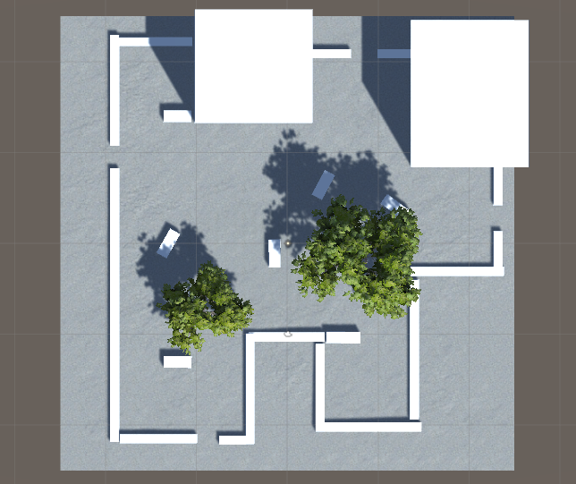
Functional Design
Level design

Slide 14
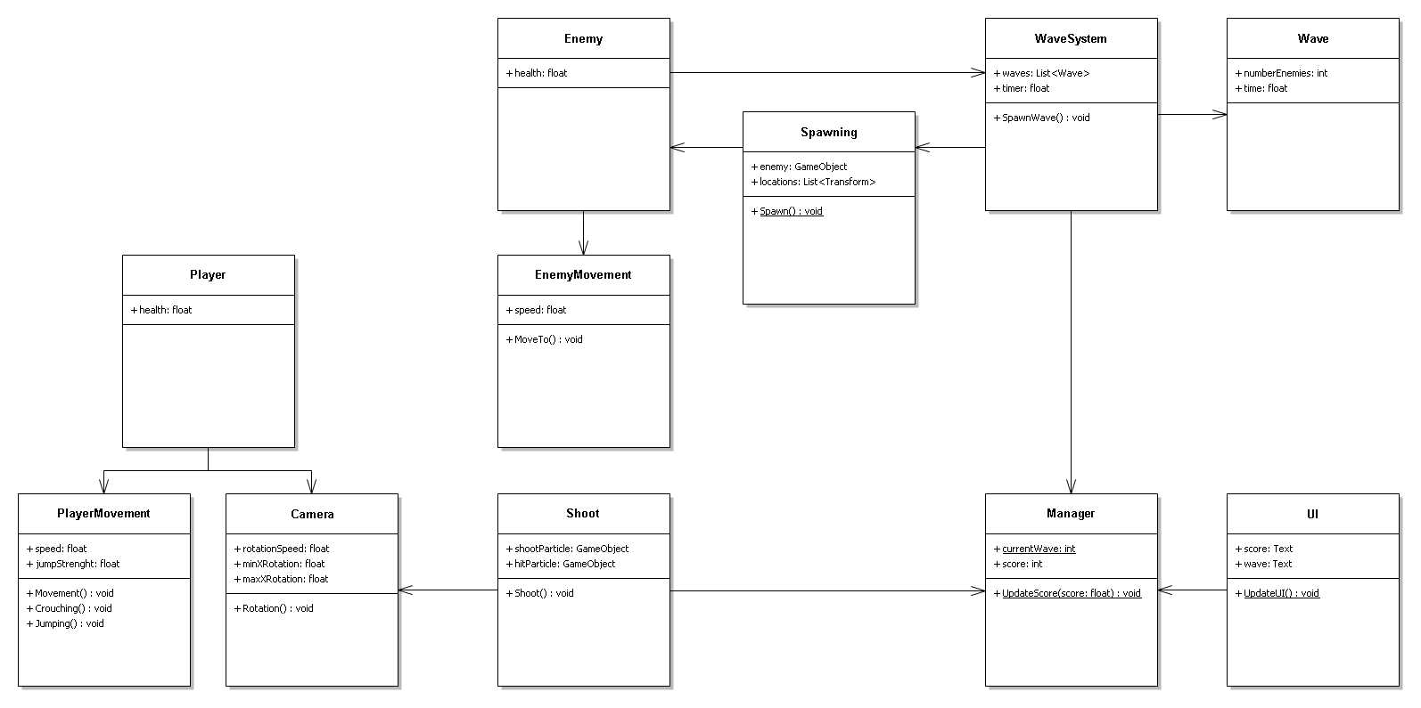
Technical Design

Slide 15
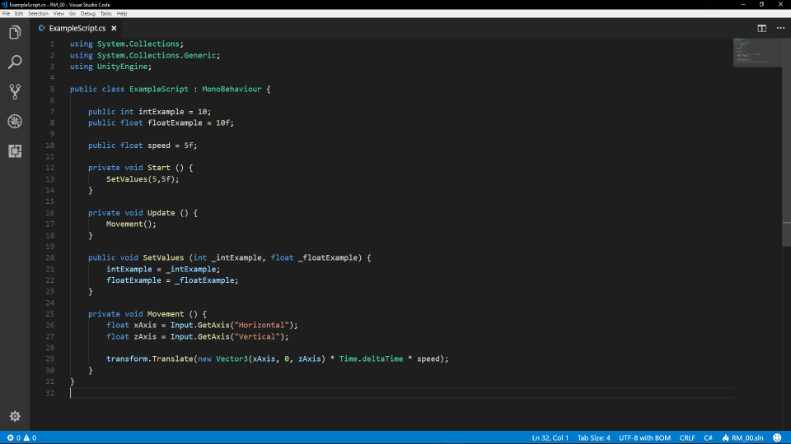
Technical Design

Slide 16
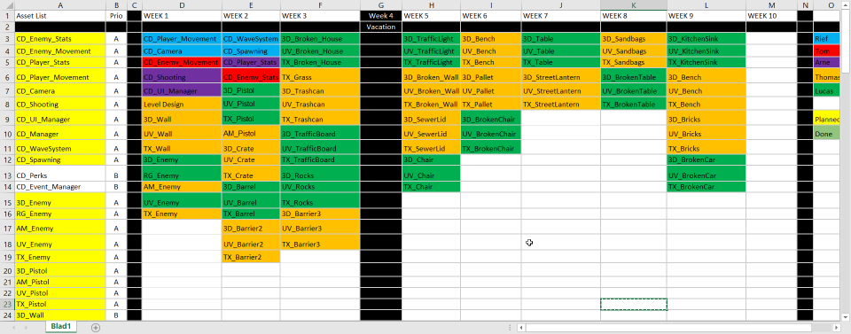
Planning
Asset list

Slide 17
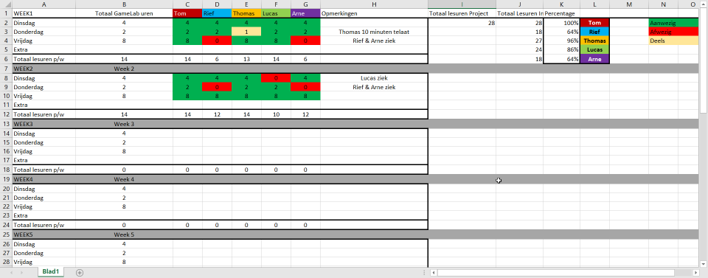
Planning
Absence

Slide 18
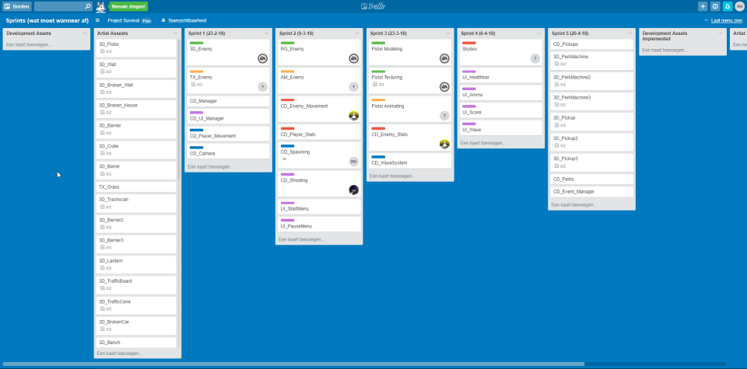
Planning
Trello

Slide 19
Organization
Naming conventions
Repository
Sources

